Slide 1
Database Design
Chapter 6

Slide 2
In this chapter, you will learn:
Changing Data Into Information
The Information System (IS)
The System Development Life Cycle (SDLC)
The Database Life Cycle (DBLC)
Database Design Strategies
Centralized vs Decentralized Design

Slide 3
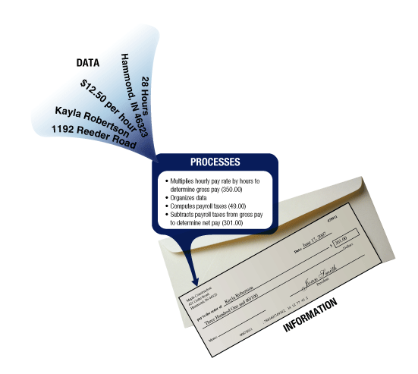
Changing Data Into Information
Data
raw facts
building blocks of information
Information
reveal meaning of data

Slide 4
Changing Data Into Information
Contracts application
programs
Data
Data
Information as
require by users
Process

Slide 5
SDLC
DBLC
1
Planning
1
Database initial study
2
Analysis
Database
design
2
3
Design
3
Implementation
& loading
Implementation
4
4
Testing
& evaluation
5
Operation
5
Maintenance
6
Maintenance
& evaluation

Slide 6
Information System
Information System (IS):
a collection of
s/w,
h/w,
data (in the database),
people,
application program and procedures
that work together to produce quality information.
the resources that enable the collection, management, control and dissemination of information throughout an organization.
a database is carefully designed and construct to store data.
database is a repository of facts in an IS.

Slide 7
Information System
Database functions in IS:
Data collection, storage and retrieval.
Transform data into information - SQL.
Manages both data and information.

Slide 8
Information System
Information system performance depends on three factors:
Database design (ERD) and implementation
Application/System design (DFD/UML) and implementation
Administrative procedures
Database development
Process of database design and implementation
Primary objective is to create complete, normalized, non redundant (to the extent possible), and fully integrated conceptual, logical, and physical database models
Implementation phase includes:
Creating database storage structure
Loading data into the database
Providing for data management

Slide 9
The System Development Life Cycle (SDLC)
SDLC is a structured approach to develop an Information System
Process of understanding how an IS can:
support business needs
designing the system
building it and deliver it to users
Different project may emphasize different parts of the SDLC or approach the SDLC phases different ways, but all projects have elements of SDLC phases

Slide 10
The System Development Life Cycle (SDLC)
1
Planning
Initial assessment
Feasibility study
2
Analysis
User requirements
Existing system evaluation
Logical system design
3
Design
Detailed system specification (ERD, Data Flow Diagram [DFD])
Input/Output screens
4
Implementation
Coding, testing, debugging (dev environment)
Installation, fine-tuning (production environment [client])
5
Maintenance
Evaluation
Maintenance
Enhancement

Slide 11
The System Development Life Cycle (SDLC)
Phase 1: Planning
An initial assessments of the information flow & extent requirements must be made:
Should the existing system be continued?
Should the existing system be modified?
Should the existing system be replaced?
A feasibility study must address the following issues if a new system is necessary:
Technical aspects of h/w & s/w requirements
The systems cost

Slide 12
The System Development Life Cycle (SDLC)
Phase 2: Analysis
Audit of user requirements
The existing h/w & s/w are studied
End users & system designer (s) work together to identify process and potential problems areas
Logical system design
Produce conceptual data model, inputs, process and expected output requirements
Systems design tools:
Entity Relationship diagrams (ERD)
Data Flow Diagram (DFD)
Defining the logical systems also yields functional descriptions of the system’s components for each process within the database environment
Usually Draft mode at this level

Slide 13
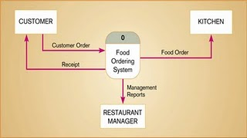
The System Development Life Cycle (SDLC)
Phase 3: Design
Detailed system design
The designer completes the design of the system’s process, including all technical specifications for:
Screen
Menus
Reports
Other devices
Conversion steps are laid out
Training principles and methodologies are planned
DFD

Slide 14
The System Development Life Cycle (SDLC)
Phase 4: Implementation
The h/w, the DBMS s/w and application programs are installed
database design is implemented
The systems enters into a cycle of coding, testing and debugging
database is created
System is customized
The database contents are loaded
Systems is subjected to exhaustive testing
Final documentation is reviewed & printed
End users are trained

Slide 15
The System Development Life Cycle (SDLC)
Phase 5: Maintenance
End users’ request for changes generate system maintenance activities
Three types of maintenance
[1] Corrective maintenance: response to systems errors
[2] Adaptive maintenance: due to changes in the business environment
[3] Perfective maintenance to enhance the systems
Computer-assisted systems engineering (CASE) technology helps within this phase

Slide 16
The Database Life Cycle (DBLC)
DBLC is inherently associated with the life cycle of the IS (SDLC)
Stages of DBLC are not strictly sequential, but involve some amount of repetition of previous stages through feedback loop
Small database system, with a small numbers of users, the lifecycle need not be very complex
Medium to large database system, with ten to thousands of users, using hundreds of queries and application programs, the life cycle become extremely complex

Slide 17
The Database Life Cycle (DBLC)
1
Database initial
study
Analyze the company situation
Define problems and constraints
Define objectives
Define scope & boundaries
2
Database
design
Create the conceptual design
Select DBMS
Create the logical design
Create the physical design
3
Implementation
& loading
Security Measures
Backup Procedures
Install DBMS
Create the database
Load or convert the data
4
Testing
& evaluation
Test the database
Fine-tune the database
Evaluate the database and its application program
5
Operation
Produced the required information flow
6
Maintenance
& evaluation
Introduce changes
Make enhancements

Slide 18
The Database Life Cycle (DBLC)
Phase 1: Initial Study
Analysis of the
company situation
company operation
company objective
company structure
Definition of problems
and constraints
Database systems
specifications
Objective
Scope
Boundaries

Slide 19
Analyze the company situation
describe general conditions in which the company operates, its organizational structure and its mission
Define problems and constraints
examine formal & informal data source to find the company information (identify company problem & constraints → business rules)
how does existing system function?
what input does the system require?
what does document the system generate
how the system output used?
who are the user of the system?
Define objectives
proposed db system must be designed to help to solve problem identified
make sure database system objective meets user requirements
Define scope & boundaries
defines the limitations of the db system

Slide 20
Business Rules
What are business rules, what is their source, and why are they crucial?
Business rules are precise statements, derived from a detailed description of the organization's operations, that define one or more of the following modeling components:
entities -in E-R model corresponds to a table
relationships -associations between entities
attributes -characteristics of entities
connectivity -used to describe the relationship classification
constraints -limitations on the type of data accepted

Slide 21
Business Rules
Examples of business rules:
An invoice contains one or more invoice lines, but each invoice line is associated with a single invoice.
A store employs many employees, but each employee is employed by only one store.
A college has many departments, but each department belongs to a single college.
A driver may be assigned to drive many different vehicles, and each vehicle can be driven by many drivers.
A client may sign many contracts, but each contract is signed by only one client.

Slide 22
Business Rules
Sources of Business Rules:
Company managers
Policy makers
Department managers
Written documentation
Procedures
Standards
Operations manuals
Direct interviews with end users

Slide 23
Fact-Finding Techniques
Fact-finding
The formal process of using techniques such as interview and questionnaire to collect facts about system, requirements and preferences.
Basically used in the early stage of DBLC.
To captures the essential facts necessary to build the required dB.

Slide 24
Fact-Finding Techniques
There are five commonly used fact-finding techniques:
Examining documents/Document review
Interviewing
Observation the organization in operations
Research
Questionnaire

Slide 25
Fact-Finding Techniques
What facts are collected?
Captured facts about the current and/or future system.
Stage of DBLC | Examples of data captured | Examples of documentation produce
Database initial study (Planning) | Aims and objective of database project | Mission statement and objectives of database system
Database initial study (System definition) | Description of user major views (includes job roles or business application area) | Definition of scope and boundaries of database, definition of users view to be supported
Database design | Users responses to checking the logical database design; functionality provided by target DBMS | Conceptual/logical database design (ERD, relational schema); physical dB design

Slide 26
The Database Life Cycle (DBLC)
Phase 2: Database Design
Part 1: Conceptual Design
(DBMS Independent)
Part 2: Select DBMS
cost, features, portability, tools,
hardware, requirements, underlying
Item A:
Data Analysis
& Requirements
Item B:
ER Modeling
& Verification
Part 3: Logical Design
DBMS dependent
Translate conceptual model to DBMS
Item C:
Data Model Verification
Part 4: Physical Design
Hardware dependent
Define storage structure &
access path for performance
Item D:
Distributed dB Design

Slide 27
The Database Life Cycle (DBLC)
Phase 3: Implementation & Loading
Part 4: Physical Design
Hardware dependent
Define storage structure &
access path for performance
Physical Design Issues
Performance
Security
Physical Security
Password security
Access rights
Audit trails
Data encryption
Diskless workstation
Backup & Recovery
Data Integrity (Referential & Entity Integrity
Company standards
Concurrency controls (Simultaneous Access)

Slide 28
The Database Life Cycle (DBLC)
Phase 3: Implementation & Loading: Security
Physical Security
Allows only authorized personnel physical access to specific areas
Not always practical → depends on the type of database implementation
Password security
Assignment of access rights to specific authorized users
Usually enforced at logon time at the operating system level
Access rights
Established through the use of database software
Restrict operation on predetermined object such as databases, tables ext

Slide 29
The Database Life Cycle (DBLC)
Phase 3: Implementation & Loading: Security
Audit trails
Usually provided by the DBMS in order to check for access violations
Data encryption
Used to render data useless to unauthorized users who might had violated some of the database security layers
Diskless workstation
The end users are allow to access to the database without being able to download the information from their workstation
Backup
Full backup = 1-to-1 copy the whole database
Differential backup = only backup changes being made after last full backup
Transaction log backup = contains all transaction log records that have been made between the last transaction log backup or the first full backup and the last log record that is created upon completion of the backup process.

Slide 30
The Database Life Cycle (DBLC)
Phase 4: Testing & Evaluation
Database is tested and fine-tuned for
Performance
Integrity
Concurrent access
Security constraints
Fine-tuning : specific systems and DBMS
Modify physical design
Modify logical design
Upgrade or change the DBMS & h/w platform
Done in a parallel with application programming
Programmers use database tools and PL/SQL
Report generators
Form creators
Menu generators

Slide 31
The Database Life Cycle (DBLC)
Phase 5: Operation
After passing evaluation stage, the database considered operational
Beginning of operational phase often starts with process of system evolution
Preventive maintenance (Backup, database security)
Corrective maintenance (Recovery, error in database structure, SQL)
Adaptive maintenance (Enhancements)
Periodic security audits
Periodic system-usage summaries

Slide 32
The Database Life Cycle (DBLC)
Phase 6: Maintenance and Evaluation
Maintenance & evaluation continues as problems detected from periodic audits exceptions
[1] Preventive maintenance
maintenance is carried out to upgrade the existing security measure
perform scheduled backup
[2] Corrective maintenance
maintenance is carried out to rectify error/bugs in database structure or SQL
Perform recovery procedure
[3] Adaptive maintenance
maintenance is carried out to adapt to new requirements

Slide 33
The Database Life Cycle (DBLC)
Phase 6: Maintenance and Evaluation
Maintenance & evaluation continues as problems detected from periodic audits exceptions
Periodic security audits
Periodic system usage summaries
Assignment of access permissions
Generation of database access statistic to improve the efficiency and usefulness of system audits and to monitor performance

Slide 34
Database Design Strategies
There are two classical approaches to database design:
Conceptual
Entity
Attribute
Attribute
Entity
Attribute
Attribute
Top-down
Bottom-up
{ Normalization }

Slide 35
Database Design Strategies
Top-down design
Bottom-up design
Starts by
identifying the data set
define data elements for each set
Suitable for dB with complex
entities
attributes
relations
transactions
Starts by
Identifying the data elements
group them together in data sets
Suitable for small dB

Slide 36
Database Design Strategies
The two general approaches to database design can be influenced by:
Scope and size of the system
Company’s management style
Company structured
Centralized
Decentralized

Slide 37
Centralized vs Decentralized Design
Centralized Design
Done by a single person for a simple and small database
Productive when the data components is composed small numbers of objects and procedure
Non-complex entities, attributes, relationships and transactions

Slide 38
Centralized vs Decentralized Design
Centralized Design
Conceptual Model
Conceptual model verification
Users view
System constrains
Data constrains
Data dictionary

Slide 39
Centralized vs Decentralized Design
Decentralized Design
Done on a database with complex entities, attributes, relationships and transactions
Also suitable if the database is spread across several operational sites
Requires very precise definition of system boundaries and interrelation between subset being model

Slide 40
Centralized vs Decentralized Design
Decentralized Design
Be careful with aggregation process:
Synonym and Homonyms
Different department might refer the same objects with different name (Synonym), and the same name might be used for different object (Homonyms)
Homonyms appear different objects have similar name.
Synonyms exist when the same objects has more than one names
Entity and entity subtypes
Different department may view entity subtypes as different entity; must integrate the subtype to higher entity
Conflicting object definitions
Attributes can be recorded at different type; must remove the conflict

Slide 41
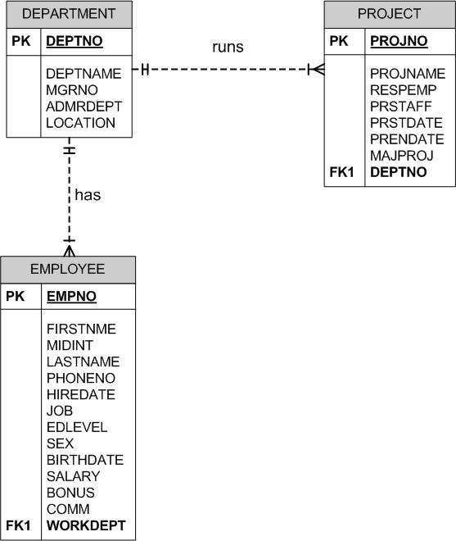
Centralized vs Decentralized Design
Homonym
Similar attribute/table names but refer to the different objects
Synonym
Different attribute/table names but refer to the same object

Slide 42
Centralized vs Decentralized Design
Decentralized Design
Submodel criteria
Data Component
Conceptual
model
Production
Marketing
Finance
Verification
View process constraints
View process constraints
View process constraints
Aggregation
Conceptual Model
Data dictionary

Slide 43
Thank you

